Slide 1
Sales & Financial Performance Dashboard
Dashboard Design: Interactive Business Intelligence Dashboard
Tool: Microsoft Power BI
Dataset: Sales Financial Datasets
Prepared by: [Nitesh Prajapati]

Slide 2
Project Objective
The objective of this project is to design an interactive dashboard that provides business stakeholders with a clear and comprehensive overview of sales and financial performance.
Key Objectives
• Monitor Total Sales and Net Profit
• Analyze Profit Margin and Units Sold
• Compare Actual Sales with Budget Sales
• Track Sales Performance Over Time
• Identify Top-Performing Products
• Analyze Department Performance
• Understand Customer Segment Contribution
• Provide Interactive Filtering using Slicers

Slide 3
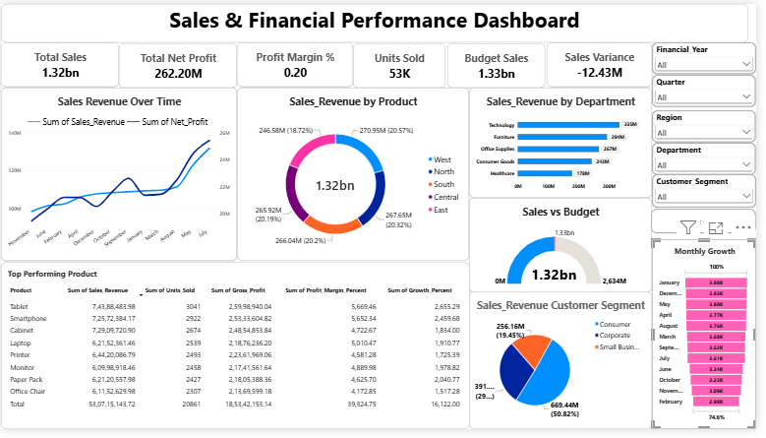
Interactive Sales & Financial Performance Dashboard
The dashboard integrates KPI cards, time-series analysis, product performance, department analysis, customer segmentation, budget comparison, and interactive slicers to support data-driven business decisions.

Slide 4
Key Performance Indicators
TOTAL SALES
$1.32B
TOTAL NET PROFIT
$262.20M
PROFIT MARGIN
20.0%
UNITS SOLD
53K
BUDGET SALES
$1.33B
SALES VARIANCE
-$12.43M
KPI Interpretation
The business generated approximately $1.32B in sales and $262.20M in net profit, resulting in a profit margin of approximately 20%. Actual sales are slightly below the budget target of $1.33B, resulting in a negative sales variance of approximately $12.43M.

Slide 5
Key Business Insights
1. Overall Sales Performance
Total sales reached approximately $1.32B, indicating strong overall revenue generation.
2. Profitability
The business generated approximately $262.20M in net profit with a profit margin of around 20%.
3. Budget Performance
Actual sales are slightly below the budget target, resulting in a negative variance of approximately $12.43M.
4. Product Performance
The product analysis helps identify products contributing significantly to overall sales and profitability.
5. Customer Segment Performance
The dashboard allows stakeholders to compare revenue contribution across Consumer, Corporate, and Small Business segments.
6. Time-Based Performance
The sales trend and monthly growth analysis help stakeholders understand changes in business performance over time.

Slide 6
Tools, Dashboard Features & Conclusion
Tools Used
Microsoft Power BI
Sales Financial Dataset
Dashboard Features
KPI Cards
Interactive Slicers
Time-Series Analysis
Product Analysis
Department Analysis
Customer Segment Analysis
Sales vs Budget Analysis
Monthly Growth Analysis
Interactive Filtering
Conclusion
The Sales & Financial Performance Dashboard provides stakeholders with an interactive and comprehensive view of business performance. It enables users to monitor important KPIs, evaluate budget achievement, analyze sales trends, identify high-performing products, and understand customer segment performance for better business decision-making.

